Slide 1


MICROSOFT 365 VIRTUAL MARATHON 2022
MAY, 4 – 6, 2022
Kai Stenberg
@blinQ
Dyn365 CS Omnichannel Voice –Teams Voice
Notes:
Welcome to my session. Today i will take you to a journey where we look into Dyn365 Customer Service Omnichannel Voice together with Teams voice also known as Teams telephony.
How to do this and what is needed to get this working.

Slide 2
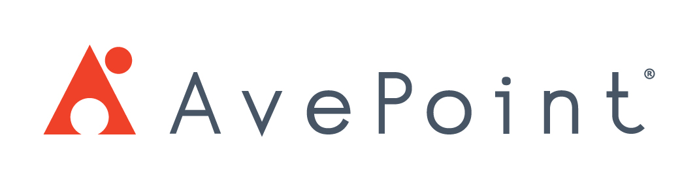








MICROSOFT 365 VIRTUAL MARATHON 2022 SPONSORS

Slide 3

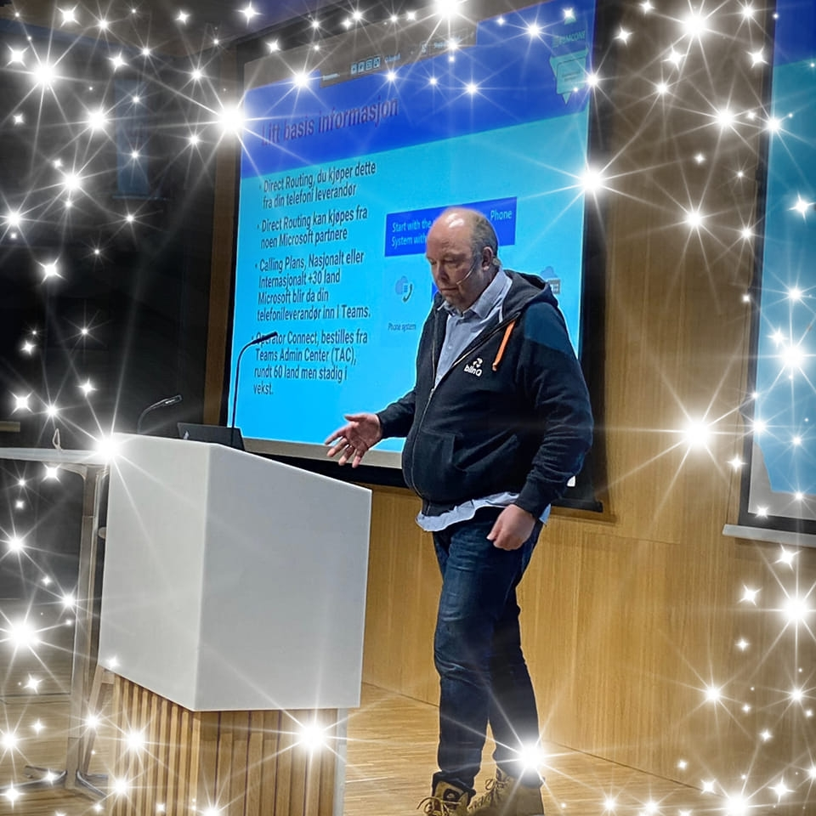

Kai Stenberg
MVP
Chief Consultant @blinQ, Norway
Siggerud, Norway, Norwegian, Swedish & English
Twitter: @kaistenberg
LinkedIn: https://www.linkedin.com/in/kaistenberg/
Microsoft MVP TEAMS, MS700, KEMP VIP
Teams and Integrations with Telco
Like Al Bundy, Married with Children
Notes:
I am from Oslo Norway, and lives south east of Oslo in a place named Siggerud. I speak Norwegian, Swedish and English.
I have been working with IT since 1996. In february I was awared with Microsoft MVP in Teams. My speciality is telephony in Teams, integrations with
Contact Center and I’m always curious how to get things work together. And this was the drive for this sessions also.
I’m married with children and has been that for almost 22 years.
Just a warning to be clear on is that I am not a Dynamics expert but I know my telco stuff and this is why I started to dig in to this topic.

Slide 4
Agenda
License information, the boring stuff ☺
Direct Routing, What are your options?
Dyn365 Sales and Teams voice How to….
DEMO – LIVE Dyn365 Sales
Azure Communication service
Dyn356 Customer Service Omnichannel Voice
DEMO – LIVE Dyn365 CS
Q/A
Notes:
The agenda that I will talk about today are:
The boring stuff like license information, what is required to get this working. I understand also that someone love license information. It needed so we will use some time on this to get the whole picture.
Direct Routing, what is this and how does it works. We need to have som basic in place.
Dyn365 Sales how to get that integrations working
Demo of Dyn365 sales, what happes when calling in and out
Azure communications service how to configure this for Dyn365CS
Dyn365 Customer service Omnichannel Voice – how we did it
Demo – Live Dyn365CS with the transcript
Got any Questions? Let’s do Q/A

Slide 5
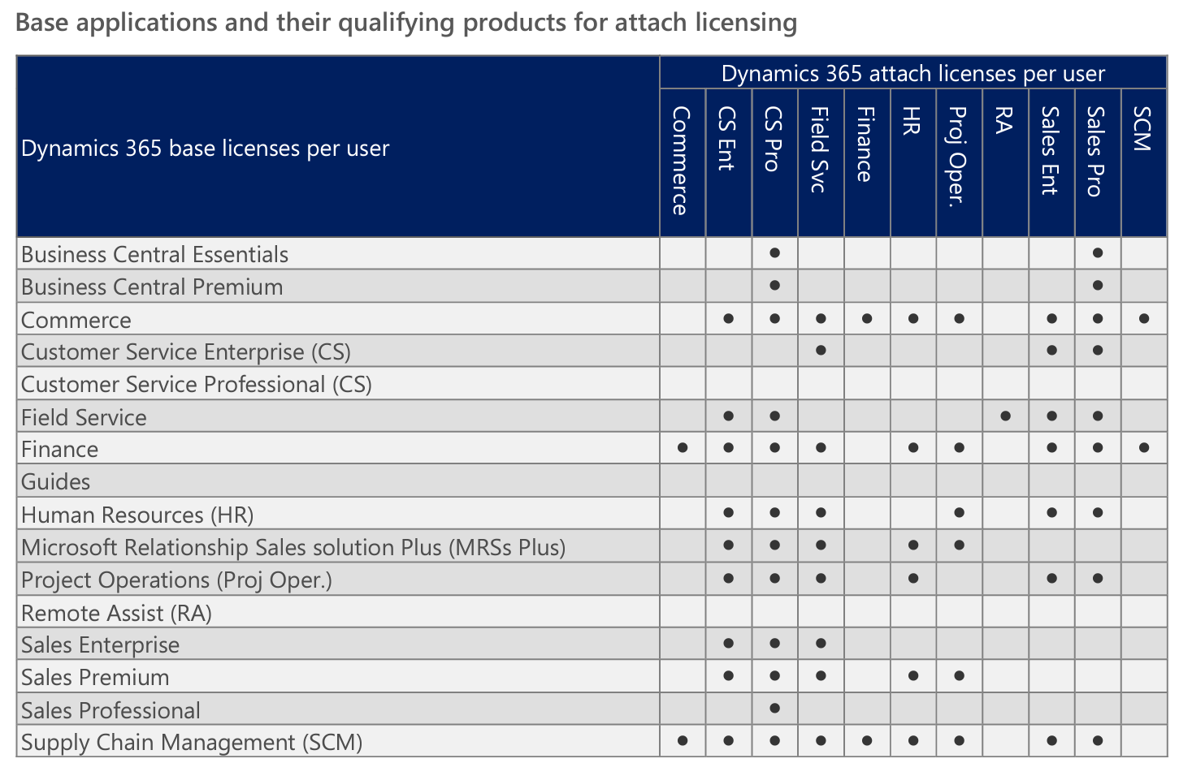
License information boring…….but a must to get this working
M365 who are not E5, well then you need addon named
Phone System Standard or Teams Phone Standard for the users also for the Small Business
M365 Virtual Phone System for Resource accounts
Dyn365 Sales Enterprise/Premium
M365 Dynamics See the table
Notes:
To get all stuff working we need to talk about license information. To get telehony in Teams using either Operator Connect or Direct Routing we need to have Phone System Standard for all the users who shall use Teams Telephony.
This is a part of E5 so if you have E5 why not enable for Teams telephony and use Teams as your softphone at work.
Are you running Calling Plans well then you need the same license.
If you have call queues and auto attendant well as long they have phonenumber they need a license who is free and named M365 Virtual Phone System.
Are you running E1-E3 and other type of license then you need to add the Teams Phone Standard or Phone System Standard. That is the same license but in different documentations you have different name on it even it’s the same.
When it comes to Dynamics license there are a jungle and I’m not a Dyn365 expert. But this table can say something about how to get the license part workling.

Slide 6
More boring stuff…..Really sorry about that
First of all you need Dyn365 Customer Service Enterprise license
Omnichannel is not included in Customer Service Pro license
Dyn365 CS Digital Messaging add-on (Nice to have)
Dyn365 CS Voice Channel Add-in
Notes:
For the solutions this is what I have up and running for my user.
If you plan to use Ominchannel voice be aware that this only support Direct Routing outside of US and Poerto Rico. If you are in US you can get your numbers direct from Microsoft.

Slide 7
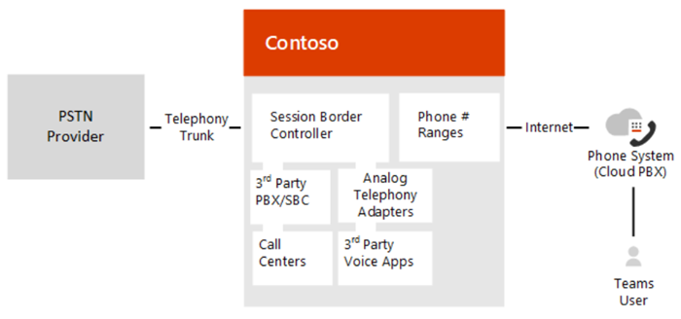
We need to get the basic running behind Direct Routing
Direct Routing let you bring your PBX to Teams
SIP-Trunk can be ordered from Telco
SBC – Session Border Controller are required
SBC can be delivered from
Your Telco (as a service)
Your Microsoft Partner (as a service)
In your Datacenter or in the cloud
Notes:
Direct rounting requires a Sesson Boarder Controller also known as SBC. You can get this from a partner or from a telco.
It can be hosted in Azure, AWS or other clouds. But you can have in you local datacenter as an appliance or a Virtual Machine. This is more up to you and how you want it.
To get this working you will need a sip trunk with phone numbers. This you can from your telco.
Some telcos deliver this as a service and have also now get this Operator Connect options in your Teams Admin Center (TAC).

Slide 8
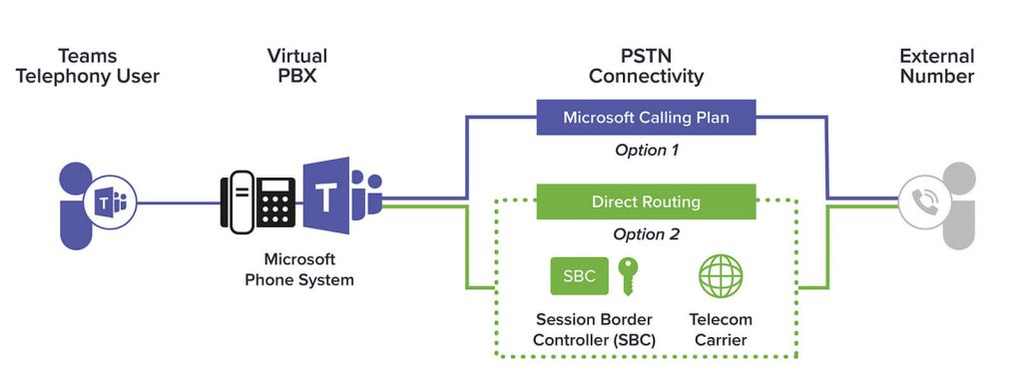
Notes:
Microsoft offers calling plans in more countries and then there is no need for SBC. Microsoft will be you telco. You can port and order new numbers into the solutions.
But Calling plans are not supported yet in the Azure Communications Service, that meens we can’t use it connected to the BOT Service for incomming calls in Omnichannel voice. Just something that we need to be aware of.

Slide 9
Time for som fun…..we got the boring stuff in place ☺

Slide 10
Dynamics 365 Sales with Voice
Notes:
Time for some cool stuff. This is basic config on how to get Teams voice in Dyn365 Sales.

Slide 11
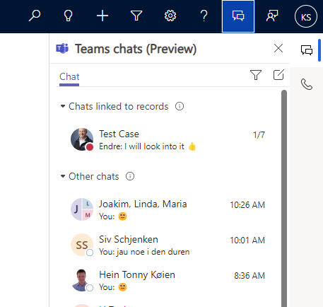
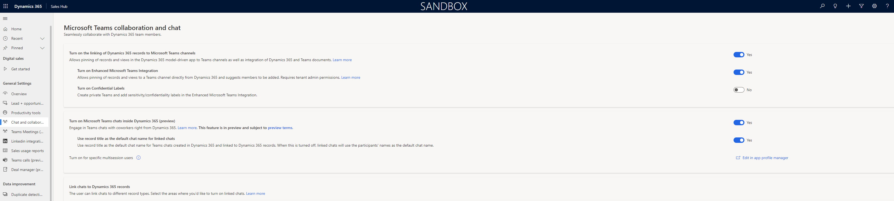
Dyn365 Sales Teams
Want to chat in Teams from Dyn365 Sales, sure you can
Create the config and the users can chat
This is done from the
Notes:
We need to configure the Teams Colab and to get this ready. When this is done all the users will have the Teams Chat ready and start to use use this functionality. Be aware that this is still in preview.

Slide 12
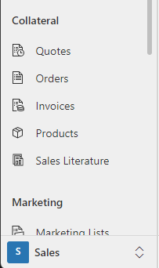
Dyn365 SALES with voice Config
First of all we need to have Dyn365 ADMIN rights
In the sales HUB
Notes:
First of all we need to look into how to configure Dyn365 Sales. We assume that Direct Routing are in place.
As mentioned we need Dyn365 admin rights to make this working and we will configure this in the Dyn365 Sales hub.

Slide 13
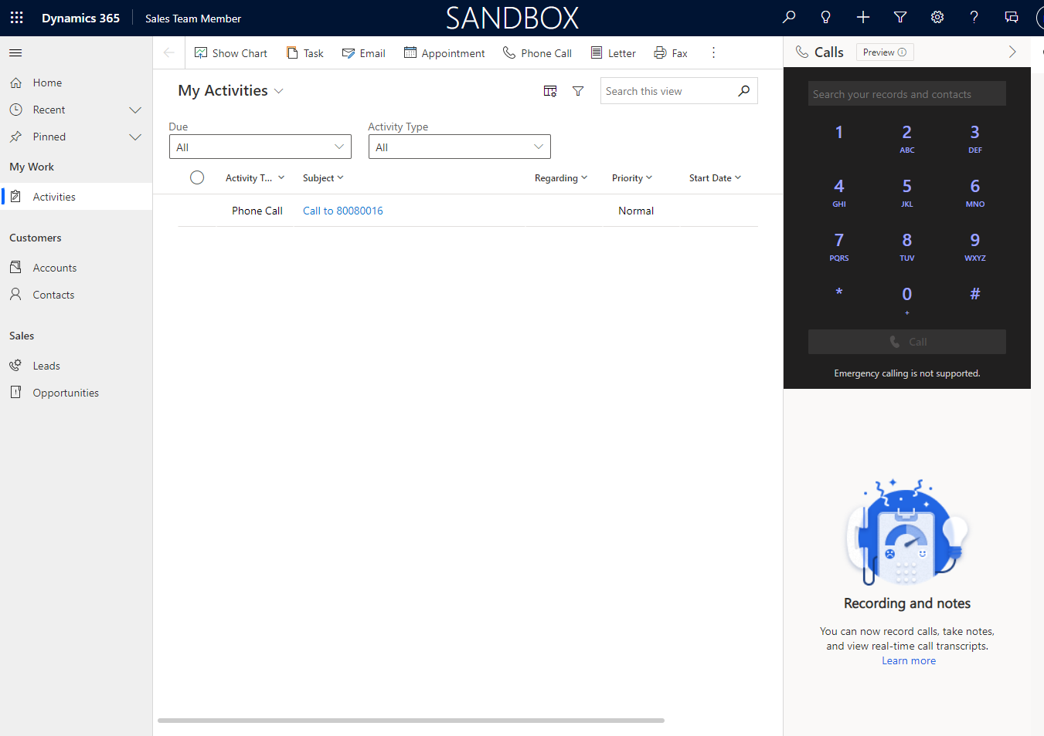
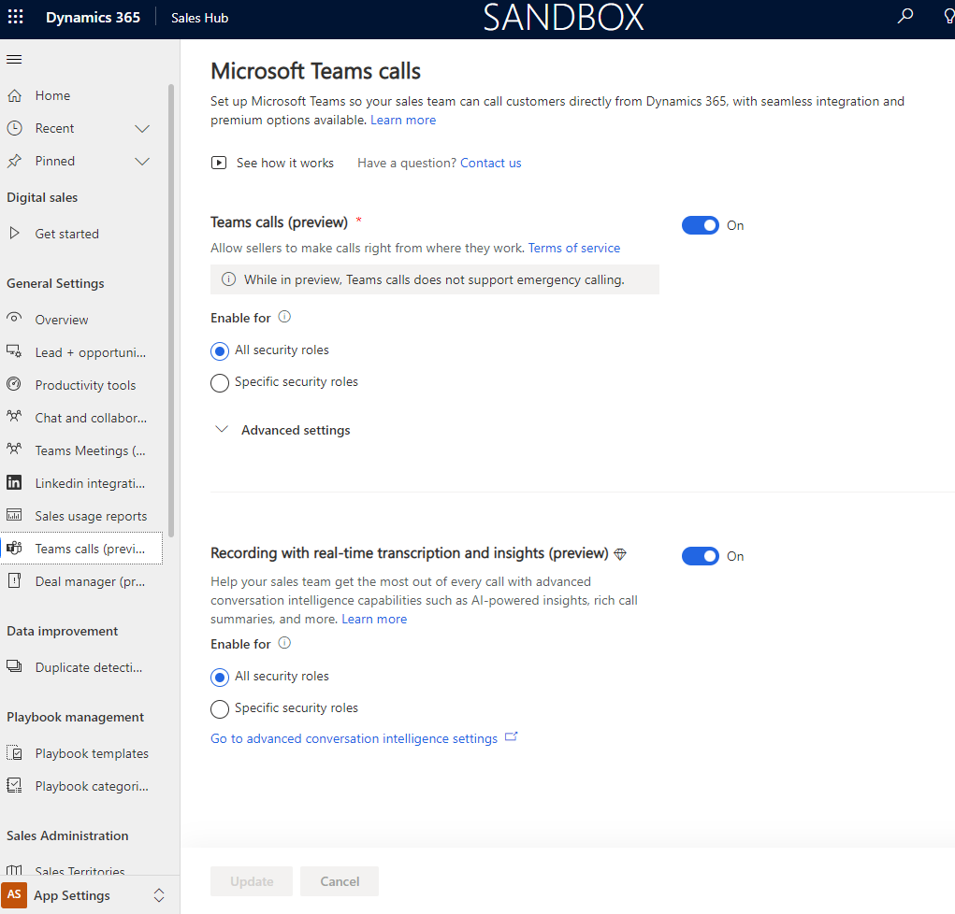
Teams Calls (in preview)
Notes:
First we turn on the feature and be aware that this are in preview and changes can come in the functionality. Recording can be done, but then it must be informed about. So my advice is to use it manual to do the recording and get concent from the person you have called.
Recordings will also give transcript but not all language are supported per now. But English, German, French, Spannish, some arabich language are there and so some of the nordic but not Norwegian. Personaly I hope that will come soon for Norwegian ☺

Slide 14
DEMO time – Teams Phone in Dyn365Sales
Notes:
Run demo of inbound and outbound calls in sales.
And ofcourse Chat from Teams inside Dyn365 Sales hub where it’s configured.

Slide 15
Dyn365 Customer Service Omnichannel with voice
Notes:
Now it’s time to look into the Dyn365 Customer Service Omnichannel with voice. I have done some basic setup so that I can call into a bot named HUGO. This askes me different thing (IVR menu) where I can for a human.
Then HUGO will transfer the call to me. At the present time the HUGO bot only speak Norwegian. But you will get the understanding in the transcript. It’s the functions we are after.
But to get there with the transcript there are several things that need to be in place.
This is how I did this together with two other Dyn365 MVP’s.

Slide 16
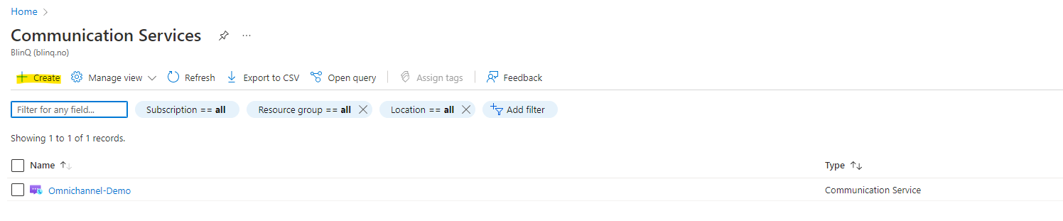
Azure Communications Service (ACS)
First connect to Azure AD
Find Azure Communication Service
Create the service
Notes:
First of all we started to configure Azure Communications Service. Here we added Resource Groups and so on. Then registred the app and more.

Slide 17
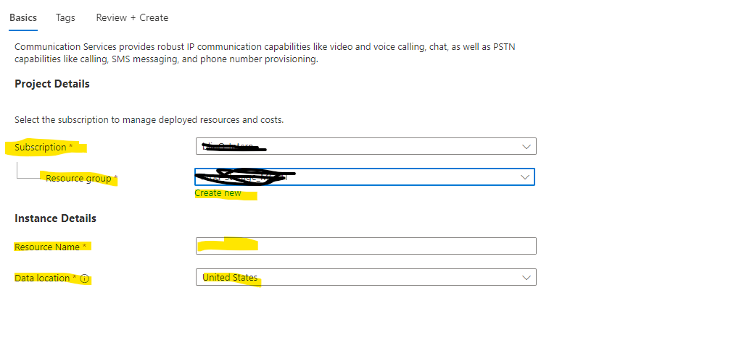
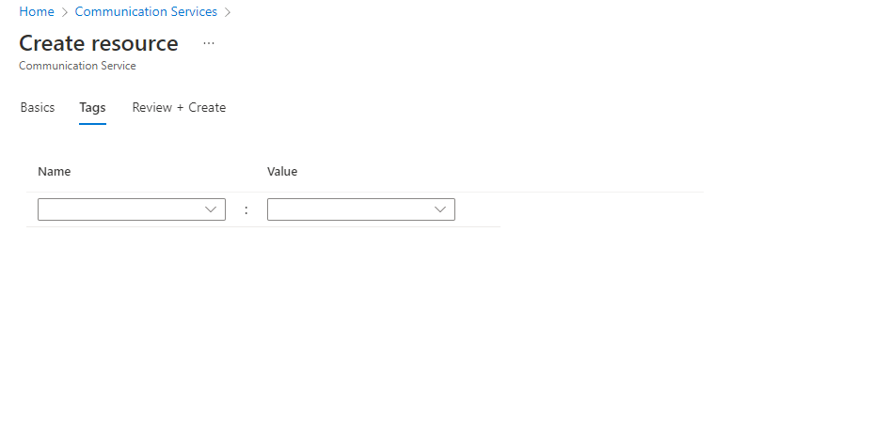
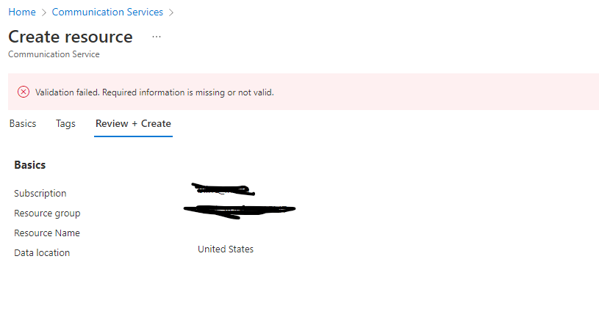
Fill in the missing parts

Slide 18
The result of the missing parts ☺

Slide 19
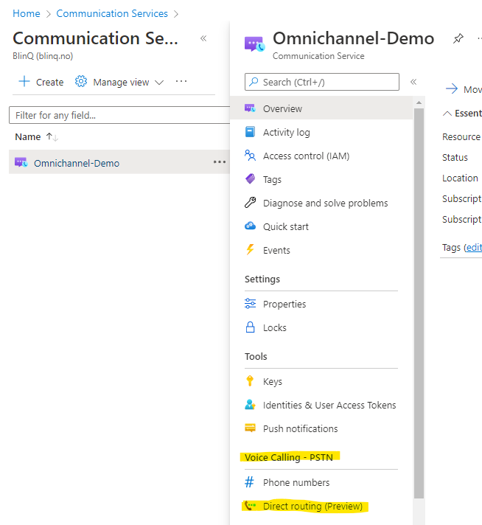
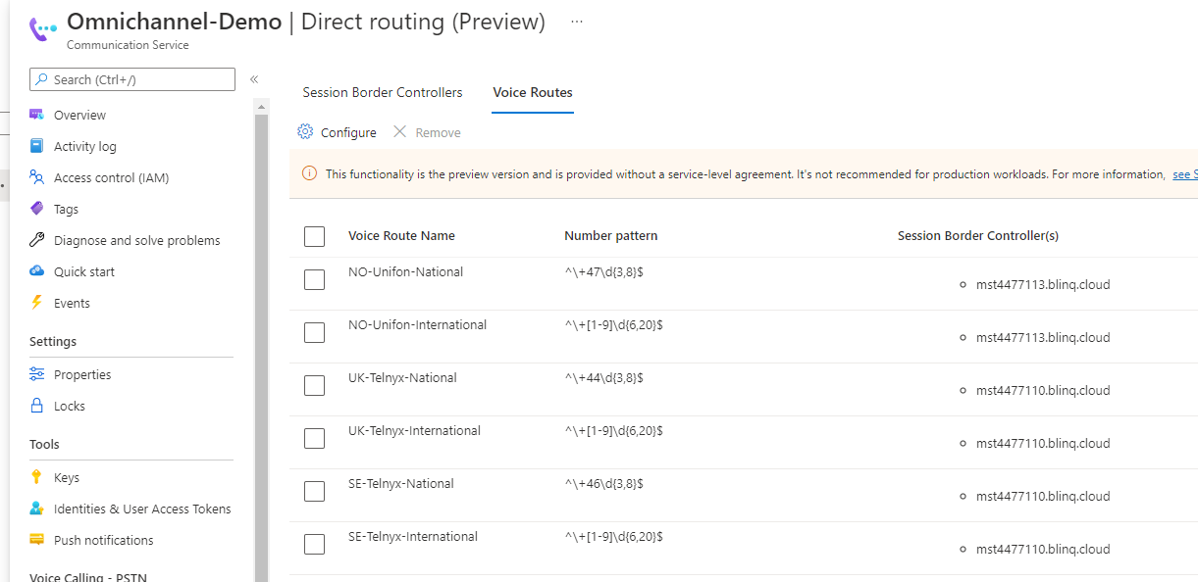
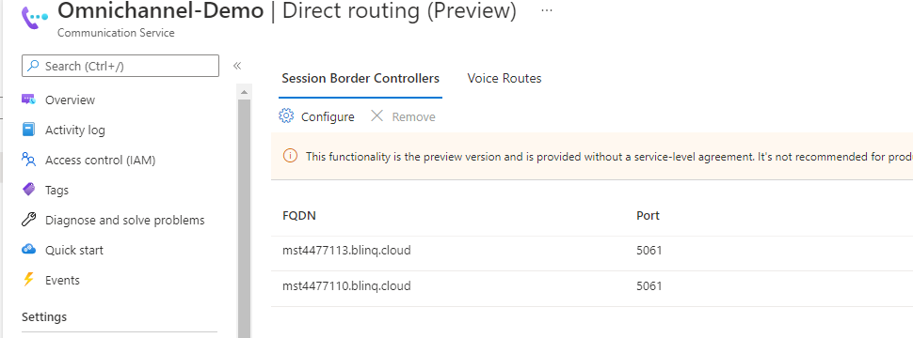
Notes:
We also added the config for the SBC since we need this for routing. All this is done in the ACS.
Here we add the SBC with the ports that we want to communicate and also the voice route. All this need to be configured before we can start to call into the system
We also need to configure the bot and more that is done in the PVA (Power Virtual Agent) and together with PowerApps to get this IVR speach to work.

Slide 20
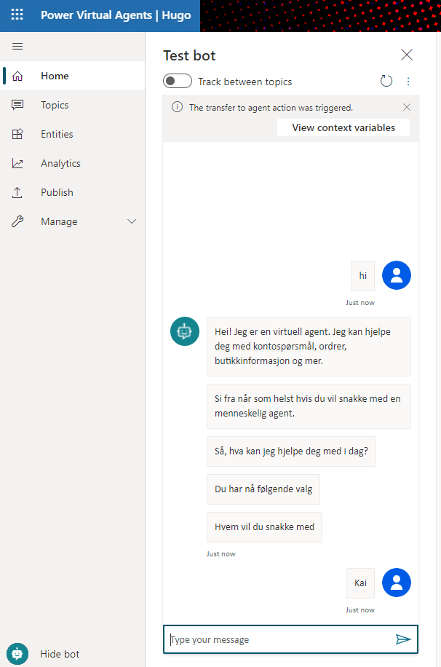
Notes:
This the dummy test of my bot. Who where I eg typ Hi, and it then list all the services that can provide to you.
Then we just say the name of the agent, and well then it transfer the call.
And when calls are transfered to the «agent», well this is what happening.

Slide 21
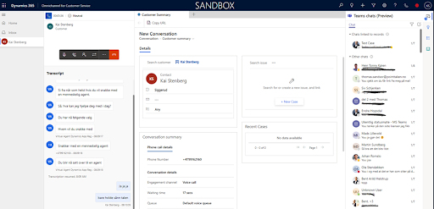
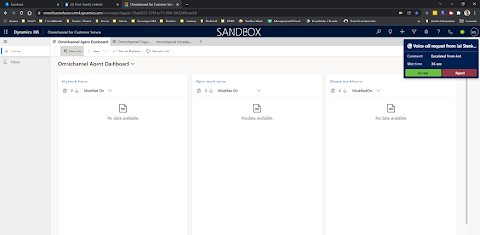
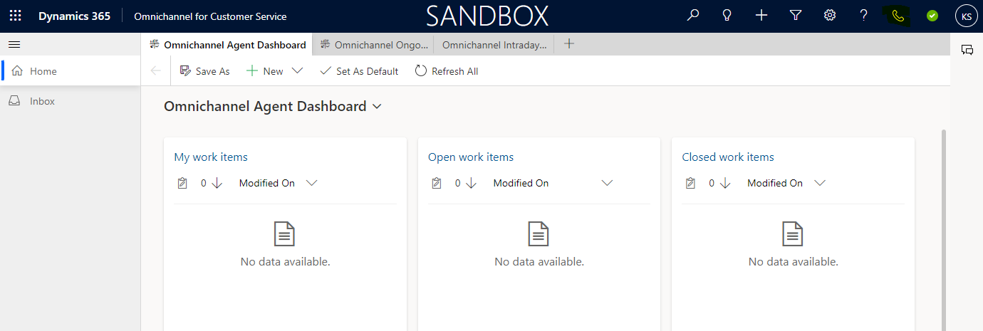
Dyn365 Customer Service Calling
We use the Azure Communication Service together with Direct Routing
BOT and phone number has been configured
AI BOT speak recognition
We got the Calling button
Notes:
Here we have the whole integrations. We have all to the right Teams chat. We can use Teams chat from the Dyn365CS, so we can ask others about a case or we also transfer to a person.
But be aware that all this are in preview and there can come changes to the function.

Slide 22
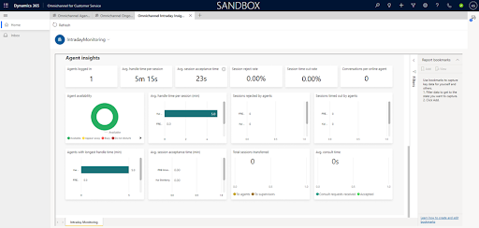
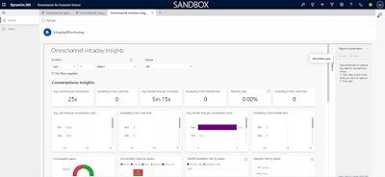
Statistics and fun
Notes:
Since we have all this in Dyn365 we have aslo lots of statistics in here. This are important for the management team to see this information.
So let’s do ready for a DEMO for the calling – chat part.

Slide 23
DEMO Dyn365CS Omnichannel Voice

Slide 24
Wrapup time……What have we learned?
Anything ? I hope so.
The basic stuff we need to get voice into some Dyn365 elements
Some telephony stuff, what we need
Seen some cool feature, hopefully
Hope to see you take the new functionality in place.
Are you running E5, please start to use Teams as your softphone, you already pay for most of it.

Slide 25
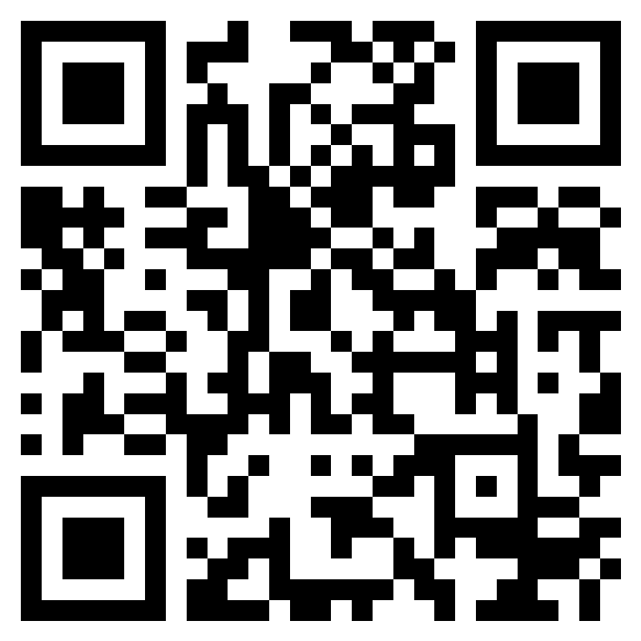
Feedback
https://forms.office.com/r/zzULt1dHLi

Slide 26

Notes:
Time for some Q and A. So if before we start this can everyone turn on their camera so that I take a picture. We just need to switch to Togethermode.

Slide 27




M365 VIRTUAL MARATHON 2022 STYLE CHEATSHEET
TYPOGRAPHY
COLOR GUIDE
DESIGN ELEMENTS
2D / FLAT DESIGN ILLUSTRATIONS, BLACK & WHITE
OR TONED WITH AT LEAST ONE COLOR FROMGUIDE,
USER AVATARS BEST ROUNDED AND BLACK &WHITE
SEGOE UI SEMIBOLD SEGOE UI SEMILIGHT
Body text 16px SECTION 28px
Underline note
HIGHLIGTED TEXT #1 HIGHLIGHTED TEXT #2
DARK VIOLET #3d3d66
BLACK #000000
VERI PERI #6667ab
LIGHT GRAY #bfbfbf
BUTTON
BUTTON
LIGHT VIOLET #8866ab
WHITE #ffffff
BUTTON

Slide 28
SPEAKER GUIDE – DELETE SLIDE
Join the session 15 minutes before the scheduled start time.
Ten minutes before the scheduled start time request to be promoted to the Presenter role.
Raise your hand to get the moderator’s attention.
@Mention the meeting Presenters and request to be promoted to Presenter.
Begin your session at the scheduled start time.
Share with the attendees if the session is being recorded.
If your session is not recorded, remind the moderator.
If you do not want your session recorded, remind the moderator
Share with the attendees if you will be sharing the slides and where they can be viewed.
Start the Q&A portion of your session by 40 minutes past the scheduled start time.
At the end of your session ask attendees to start their video stream and take a Together Mode photo.
Please TWEET the photo and include the #M365VM hashtag

Slide 29
MODERATOR GUIDE – DELETE SLIDE
Display the countdown timer screen.
Identify the session speaker and promote speaker to the Presenter role.
Speakers are encouraged to join the meeting, raise their hand, and/or @mention meeting Presenters to request promotion from attendee to presenter.
Introduce the session speaker.
We recommend reading the speaker’s bio, as-well-as the full description of the session.
Optional – Ahead of the session, choose appropriate music that you can play between sessions.
We recommend the Lofi music genre
If the speaker does not arrive by the scheduled start time, display the unplanned issue screen.
If the speaker arrives on time, start recording the session at the scheduled start time.
Stop recording when the speaker finishes their session, including the Q&A portion.
Display the countdown timer screen for the next session you will moderate.

